Slide 1

Notes:
Thank you for this opportunity to introduce all that Taiwan has to offer.

Slide 2

Notes:
Taiwan is located in the Heart of Asia with the Taiwan Strait and the Asia mainland to the west and the Pacific Ocean to the east.

Slide 3



5:00 a.m.
Wake up with the sun
Notes:
There is always something interesting to see and do whatever the time of day. Let me give you an example of what you can do in one day in Taiwan.

Slide 4

Notes:
The day starts with a spectacular mountain sunrise, accompanied by a sea of clouds and mist at Zhushan in the Alishan Forest Recreation Area.

Slide 5
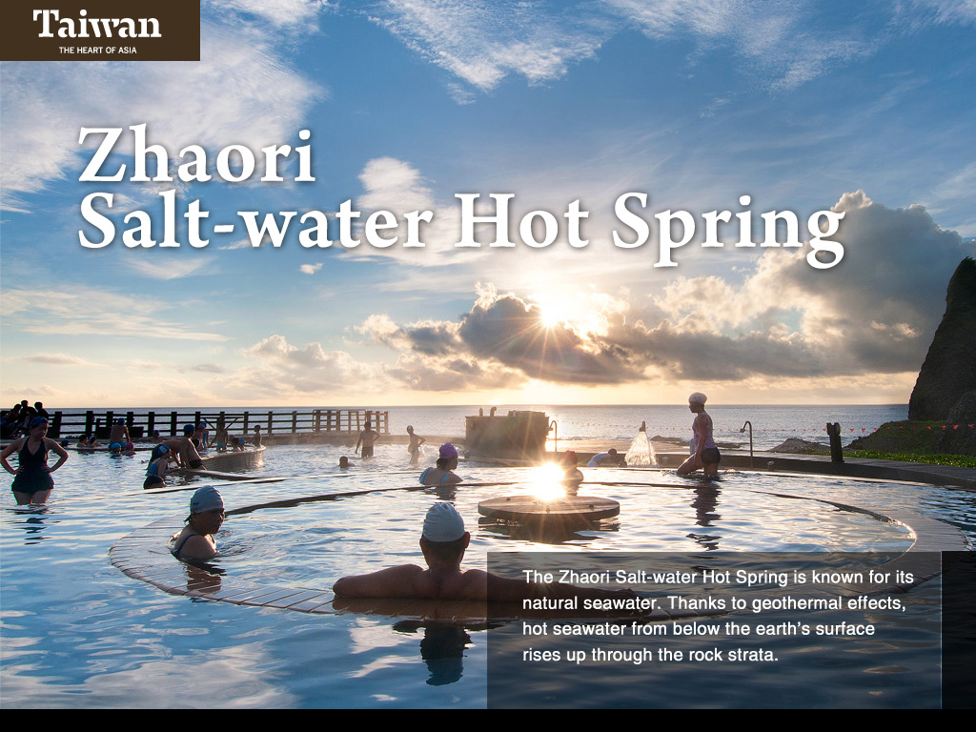
Notes:
The east coast also boasts breathtaking sunrises. Enjoy the early morning at the Zhaori Salt-water Hot Springs on Green Island, it’s also one of the few natural salt-water hot springs in the world.

Slide 6
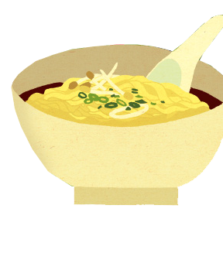
7:00 a.m.
Authentic Taiwanese breakfast
Notes:
Taiwan is famous for the variety and tastiness of its food. This begins with the first meal of the day—breakfast.

Slide 7

Notes:
There is a wide range of breakfast options in Taiwan. One of the most popular Taiwanese breakfast foods is shao bing and you tiao or layered flatbread with fried bread sticks, it creates an interesting sandwich-like combination.

Slide 8

Notes:
Although Western-style omelets are readily available, why not try a Taiwanese style one? This scallion omelet is wrapped in a thin pancake and is usually topped with thick soy sauce.

Slide 9

9:00 a.m.
Enjoy the great outdoors
Notes:
The Tropic of Cancer runs through Taiwan separating it into subtropical and tropical climate zones. The climate is warm most of the year, perfect for outdoor activities.

Slide 10
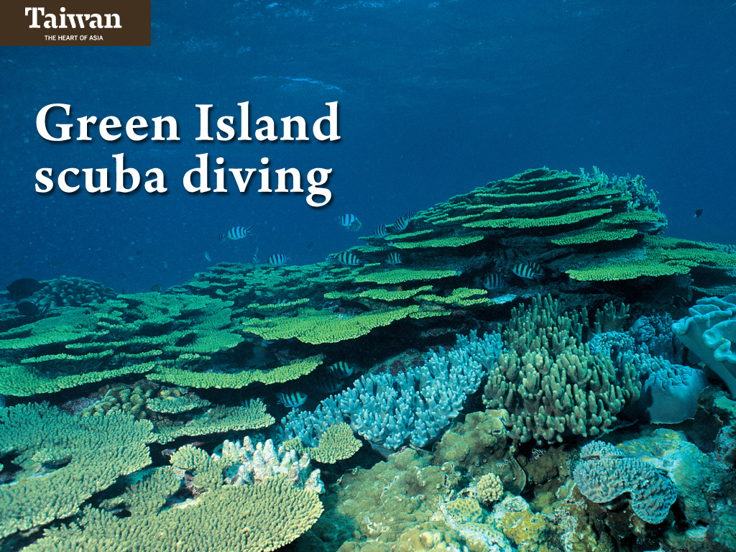
Notes:
As Taiwan is surrounded by ocean and coral reefs, there are many great places for scuba diving and snorkeling including Kending, Orchid Island and Green Island. Both Green Island and Orchid Island are located off the shore of eastern Taiwan in the Pacific Ocean.

Slide 11
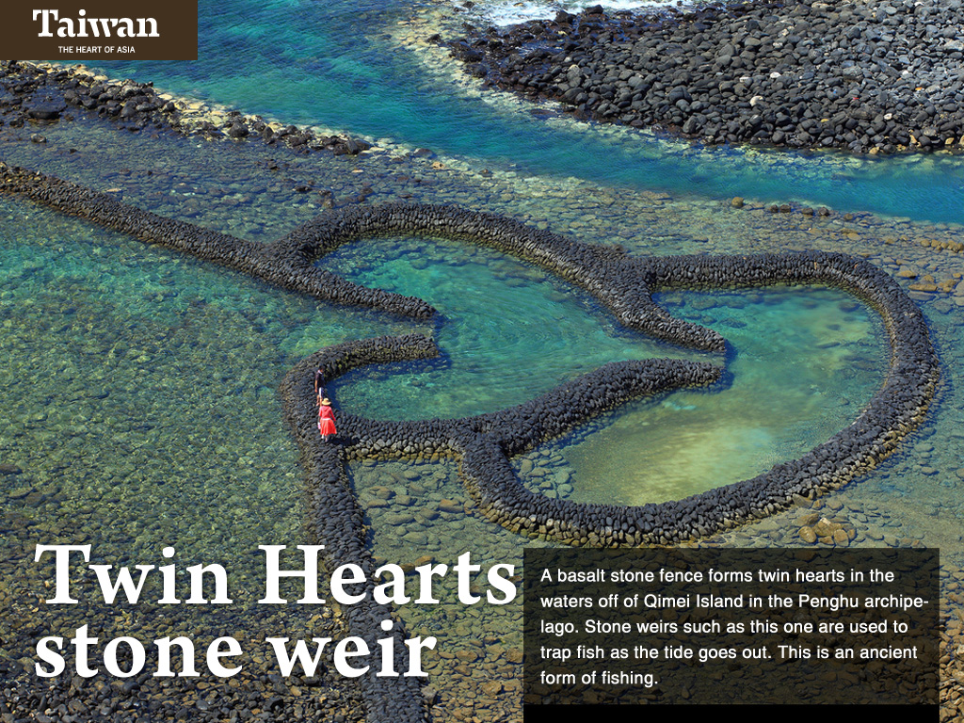
Notes:
The Penghu archipelago is best reached from the western coast of Taiwan. Here, an ancient form of fishing is still practiced. A weir is a stone fence used to block the passage of fish as the tide goes out. This one in the waters off of Qimei Island is the most famous for its twin heart shape.

Slide 12
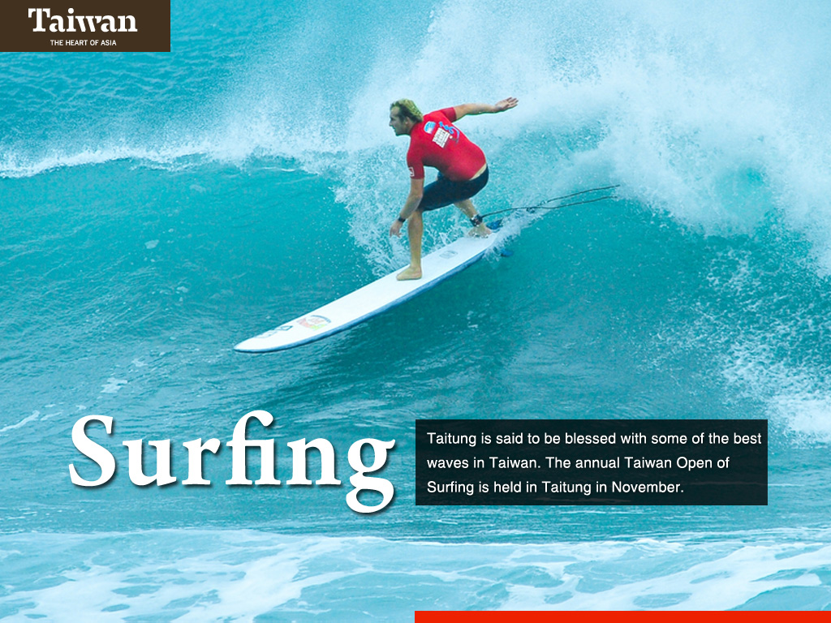
Notes:
Although not the only place for surfing in Taiwan, the coastline of Taitung County in eastern Taiwan is said to be blessed with some of the best waves. The annual international Taiwan Open of Surfing is held here in November.

Slide 13
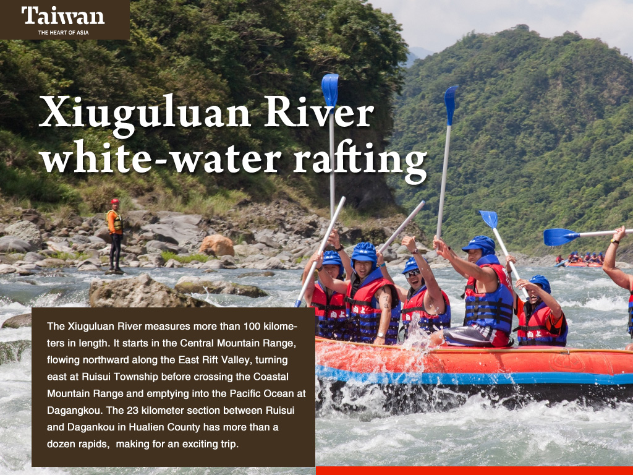
Notes:
The Xiuguluan River measures more than 100 kilometers in length. The section between Ruisui Township and Dagangkou in Hualien County has more than a dozen rapids making for an exciting trip any time of the year.

Slide 14
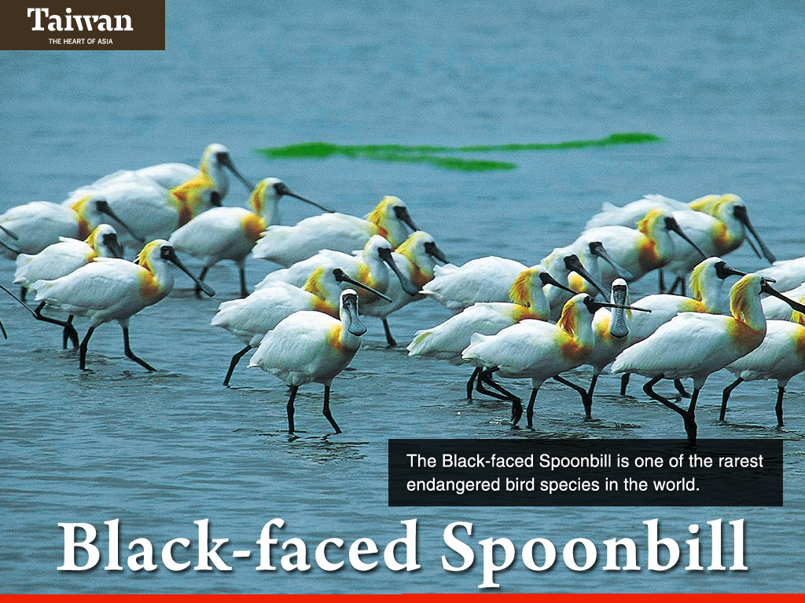
Notes:
And you can’t forget about bird watching. Where you can get a good luck at one of the most rare birds in the world, the black-faced spoonbill.

Slide 15
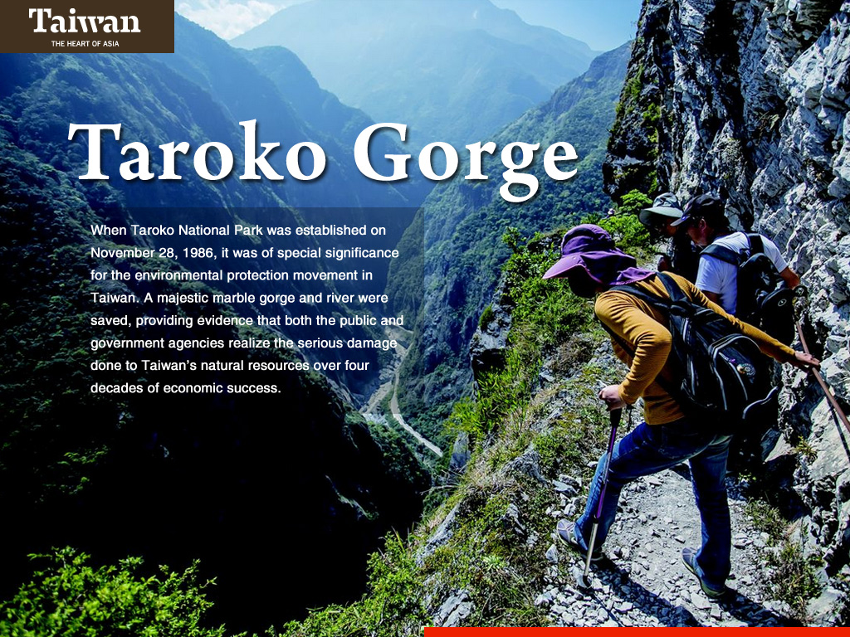
Notes:
No trip to Taiwan is complete without a visit Taroko Gorge in Hualien County. This gorge was formed over millions of years,compressed under high pressure and heat to create marble that has been slowly eroded by the aquamarine waters of the Liwu River. One of the most challenging activities is to climb the summit of Yushan, also known as Mt. Jade, the tallest peak in Northeast Asia measuring 3,952 meters in height.

Slide 16
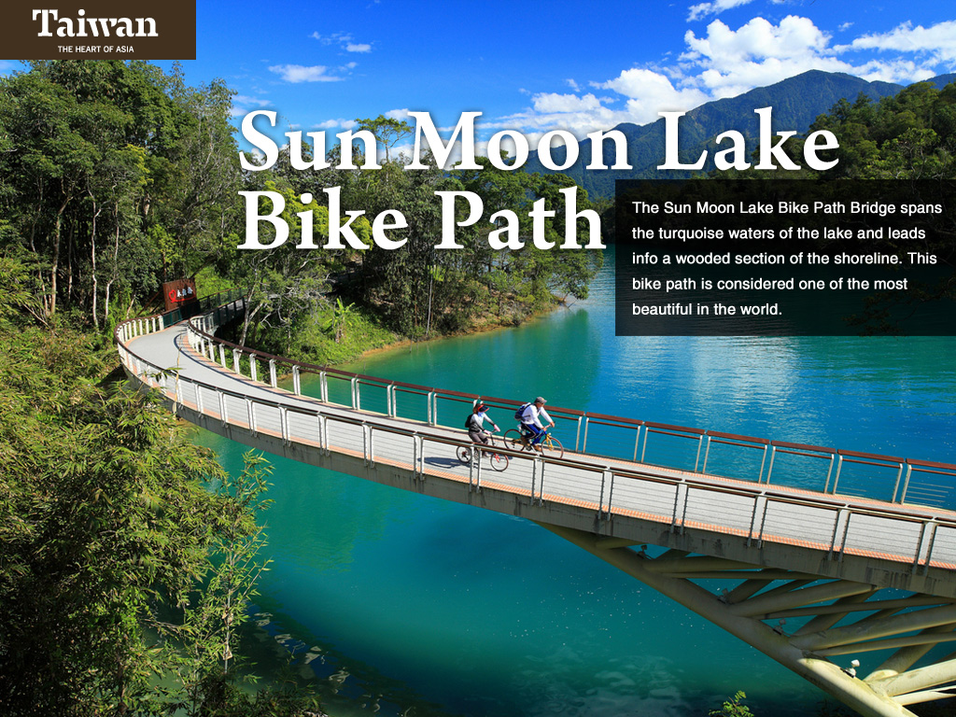
Notes:
Taiwan is quickly becoming a cyclist’s heaven with many bike paths and trails located all around the island. One of the most famous is the 30-kilometer path that circles Sun Moon Lake. This was named one of the top ten most beautiful bike paths in the world by CNNGo.

Slide 17

Notes:
Taiwan’s residents are becoming more and more active and this has caught the attention of the world. There are number of fun runs and international marathons each year.

Slide 18

12:00 noon
Comfort food
Notes:
A morning of outdoor activities is sure to have left you with a good appetite. There are many delicious foods to try.

Slide 19
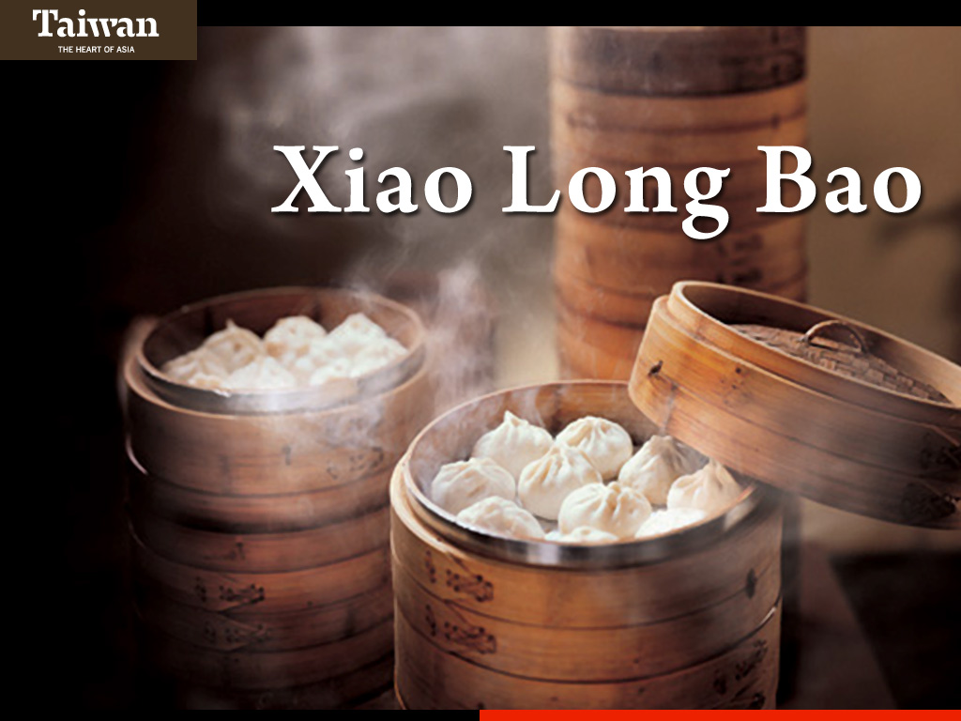
Notes:
Steamed dumplings are a favorite among tourists and locals alike. There are also boiled and fried dumplings, known as pot stickers.

Slide 20
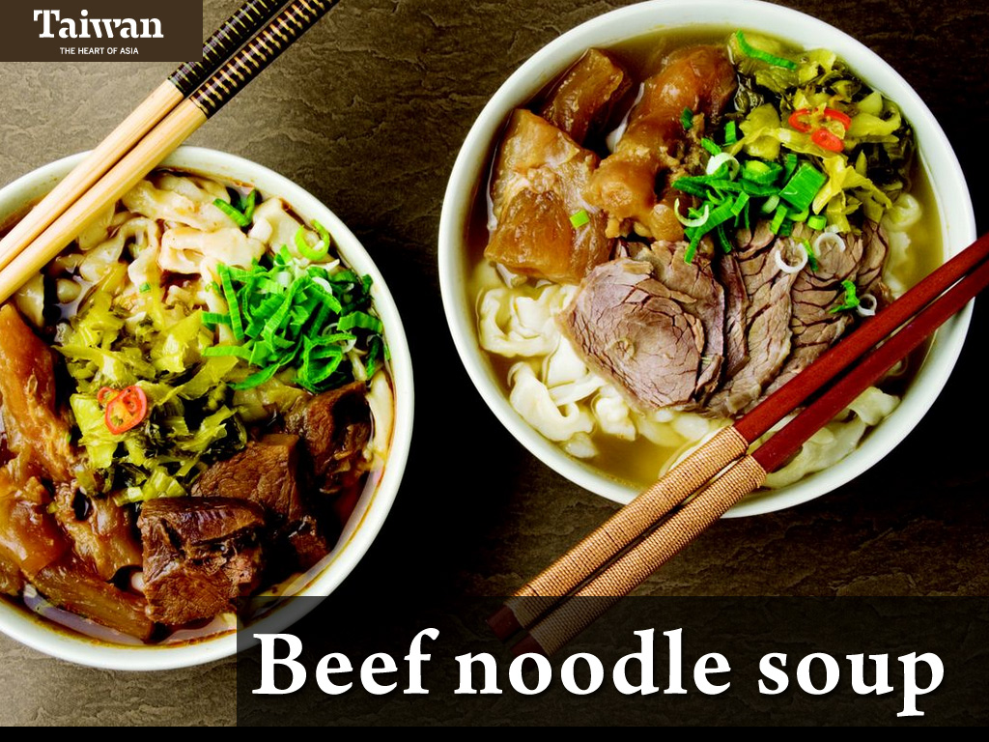
(niu rou mian)
Notes:
Beef noodle soup is popular especially in winter.

Slide 21

Notes:
Taiwan’s culinary delights extend to the gourmet and are innovative in a variety of themed restaurants located in natural and urban settings.

Slide 22
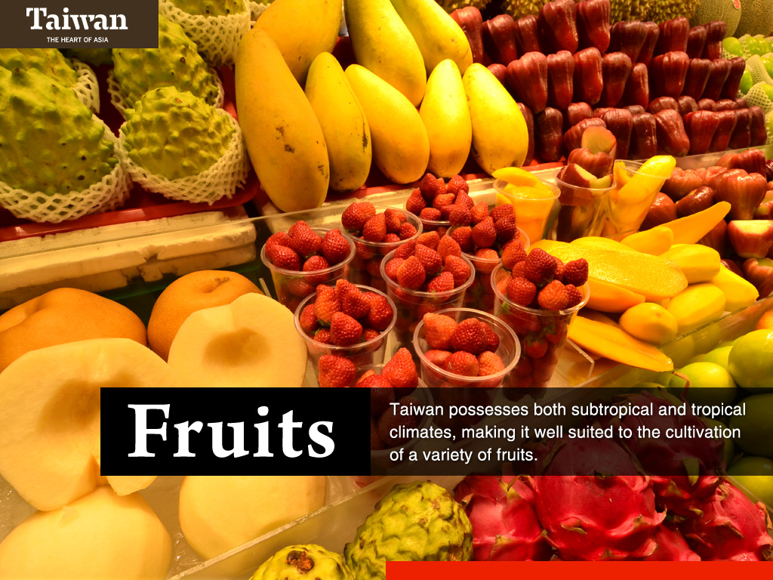
Notes:
The tropical climates provide perfect conditions for fruits, such as pineapple, guava, mango, papaya, banana, dragon fruit, lychee, and custard apple.

Slide 23
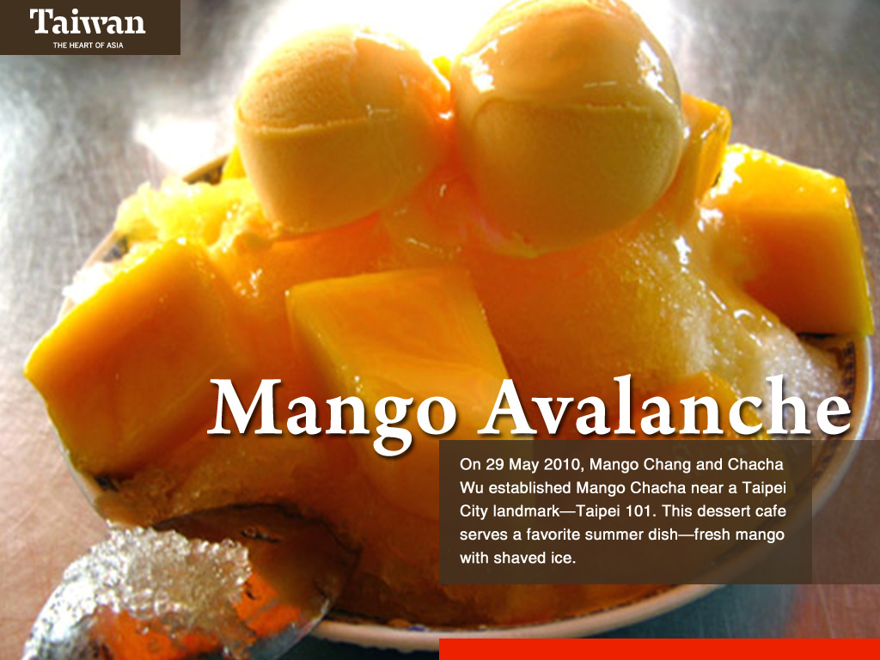
Notes:
In the hot summer months, the most famous fruit is mango. These are combined with shaved ice to create cool desserts.

Slide 24
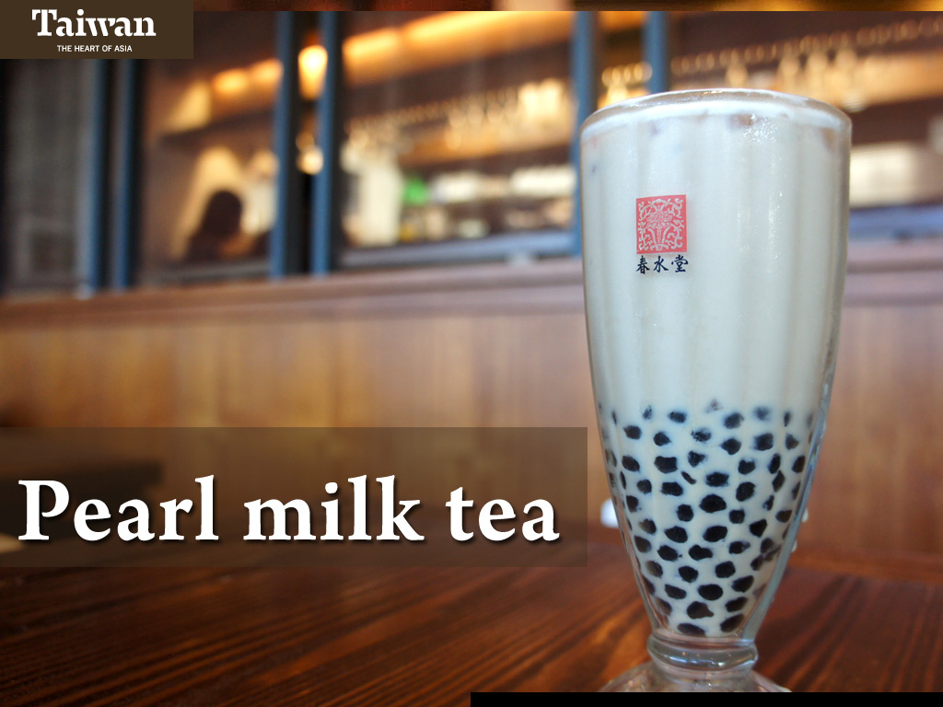
Notes:
Another tasty treat is pearl milk tea. This is milk flavored tea to which gelatinous balls of tapioca are added. Bubble tea and pearl milk tea stands and shops are opening up all over the world, including in Europe and North America.

Slide 25
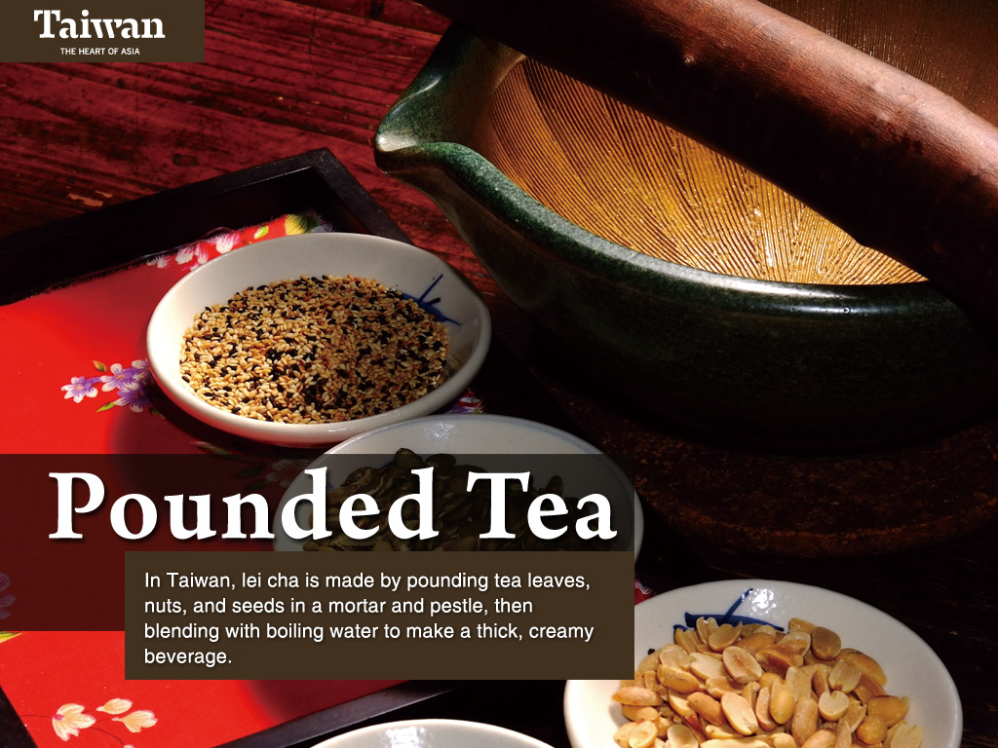
Notes:
We should also mention pounded tea. With all the diverse available in Taiwan.

Slide 26

14:00 p.m.
Travel back in time
Notes:
Taiwan’s indigenous peoples arrived some 6,000 years ago. From the 16th century, the island caught the attention of many foreign powers such as the Netherlands and Spain. There was an influx of immigrants from southern China starting in the 17th century. Then, Japan came to occupy Taiwan for 50 years from 1895-1945.

Slide 27
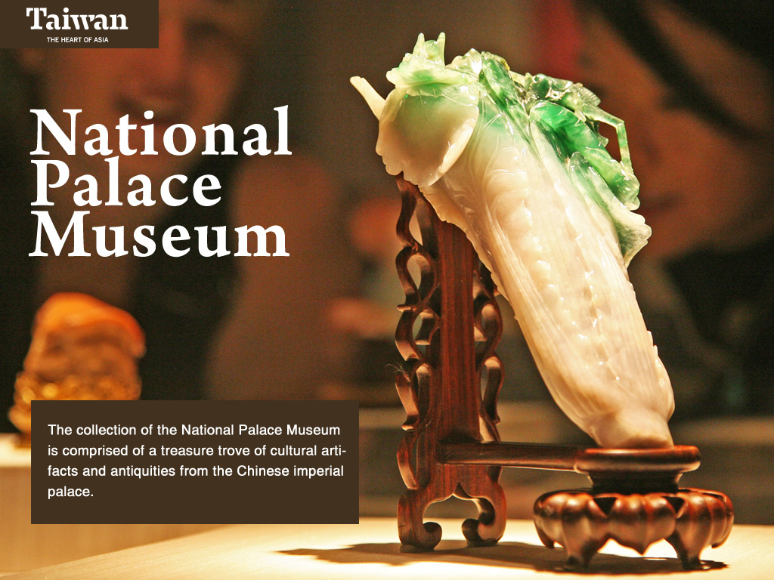
Notes:
In the late 1940s, the end of the Chinese Civil War, the Kuomintang and its supporters retreated to Taiwan. During the fighting in China, the essential part of the art collection of the imperial palace was moved from place to place to protect it. It finally arrived at its current home, the National Palace Museum.

Slide 28
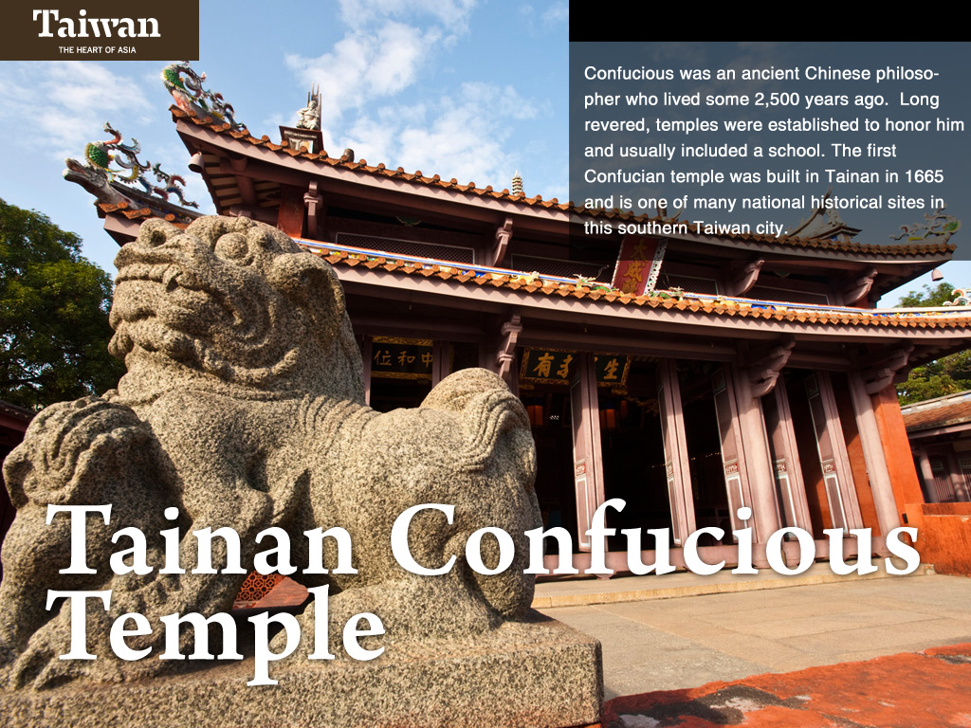
Notes:
Confucius was an ancient Chinese philosopher who lived some 2,500 years ago. Taiwan’s major cities each have a Confucian temple, with the oldest in Tainan, built in 1665.

Slide 29
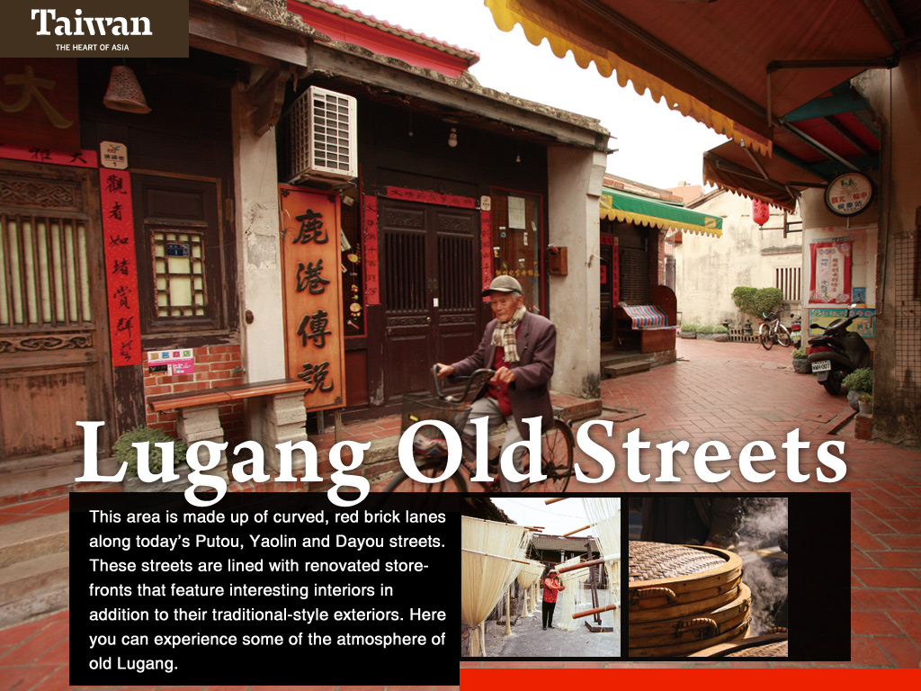
Notes:
Lugang literally means “deer harbor”. This is because in the 17th century, deer skins and other products were exported from this harbor, mainly to Japan. Although this is no longer a major commercial center, many of its buildings and narrow, winding alleys have been preserved, making it an important and interesting tourist destination.

Slide 30
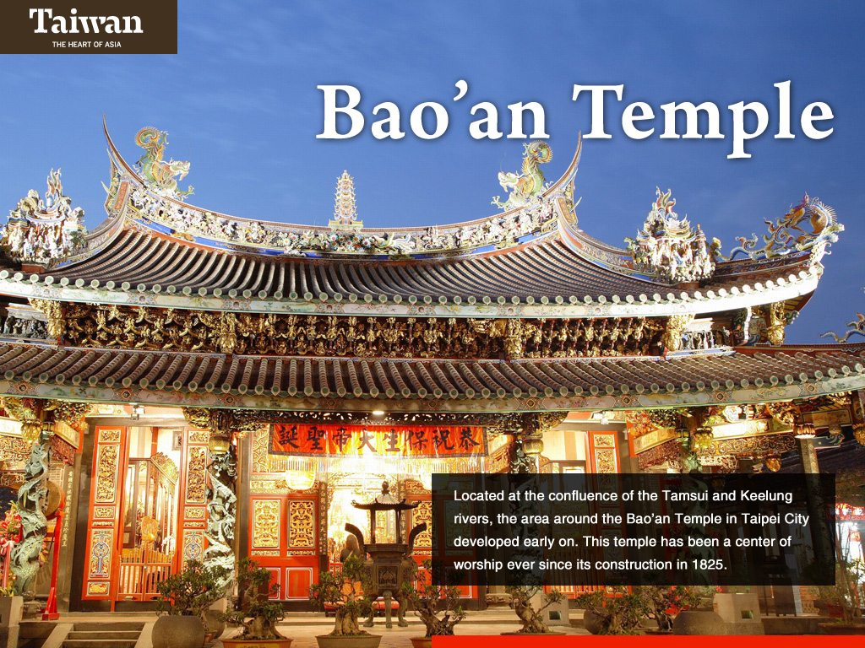
Notes:
The Bao’an Temple was first built as a simple, wooden shrine to protect the people of this area of Taipei in the late 18th century. This is a national historic site and has been recognized by UNESCO with an Asia-Pacific Heritage Award for Cultural Heritage Conservation.

Slide 31

Notes:
In the 17th century, the Dutch East India Company occupied Fort Zeelandia in today’s Tainan City for nearly 40 years. However, the Dutch surrendered to the invading army of Koxinga, a Chinese warlord, and left Taiwan in 1662. Koxinga moved into Fort Zeelandia, renaming it Anping.

Slide 32
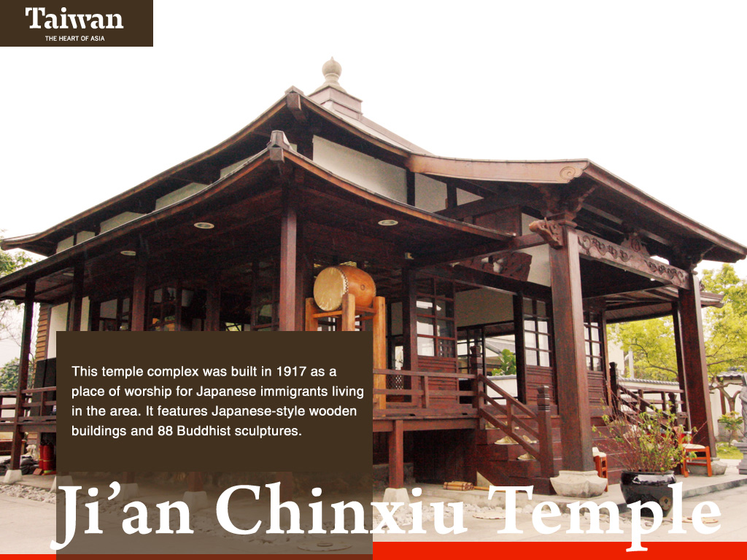
Notes:
Japan occupied Taiwan for over 50 years, there was an influx of Japanese administrators, teachers and soldiers. This temple complex was built in 1917 in Ji’an Township of Hualien County.

Slide 33
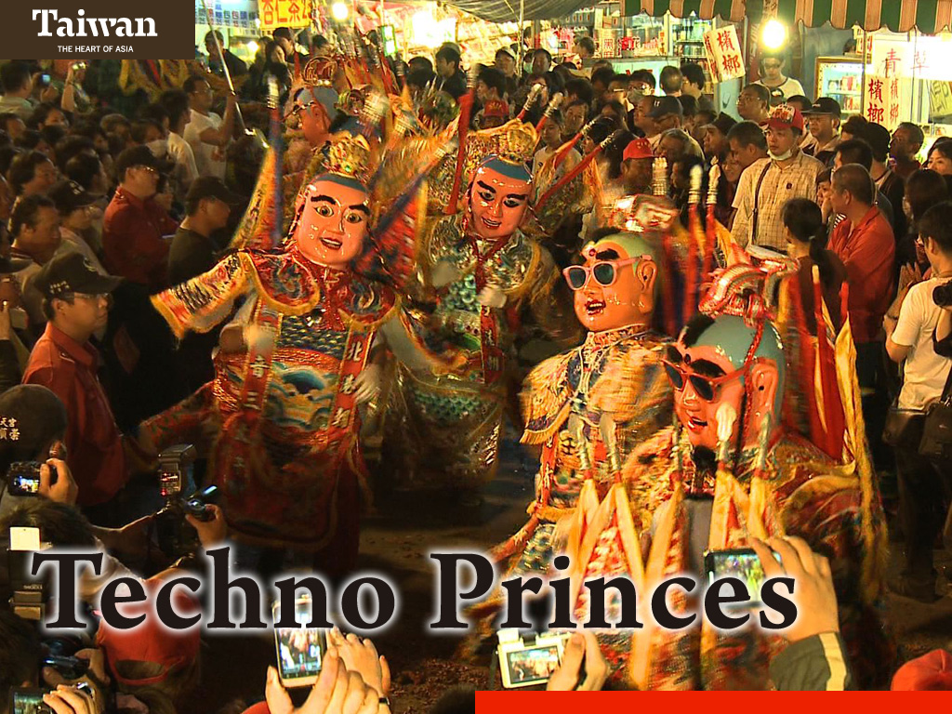
Notes:
These are representatives of Santaizi, a god important in Taiwan’s folk Buddhist and Taoist beliefs. Due to the legend of his taking his own life at the age of seven to save his parents from the wrath of the Jade Emperor, he is usually pictured as a large child.

Slide 34
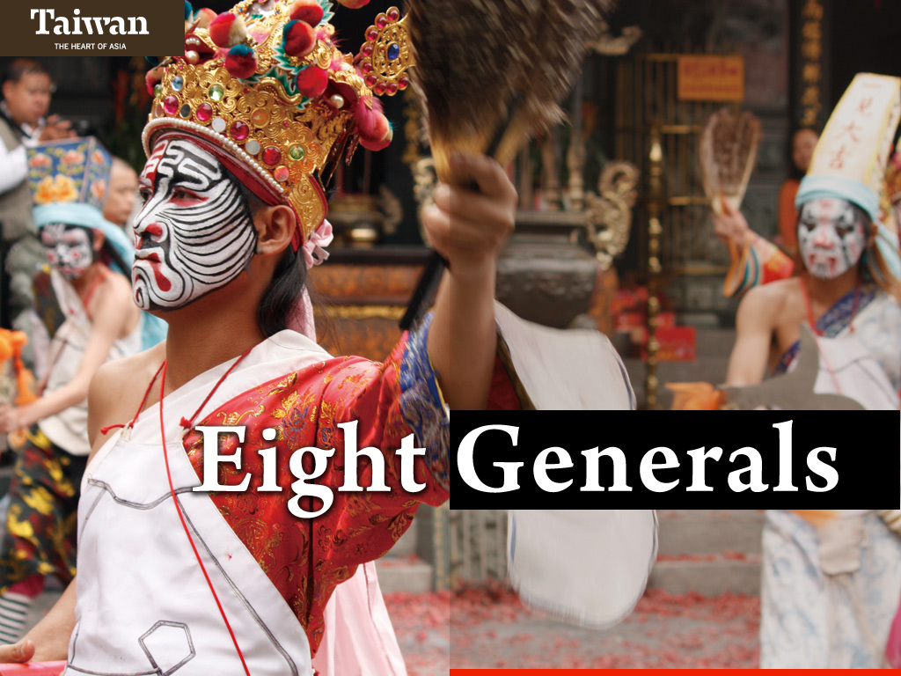
Notes:
Ba Jia Jiang are considered bodyguards to various deities in Taiwan’s folk religious beliefs, thus they are often part of temple festivals.

Slide 35
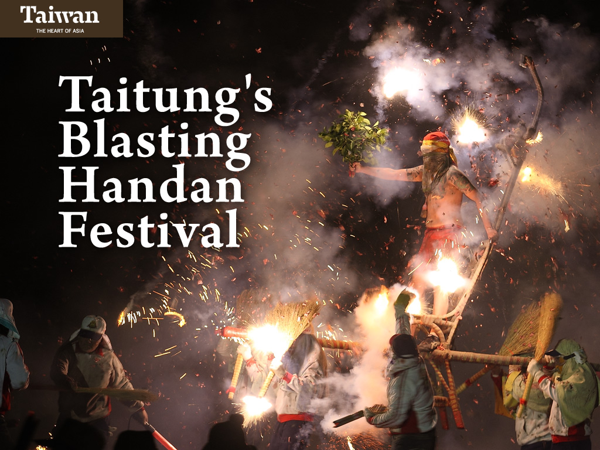
Notes:
There are several religious festivals that are unique to Taiwan. For example, Taitung’s Blasting Handan Festival,

Slide 36
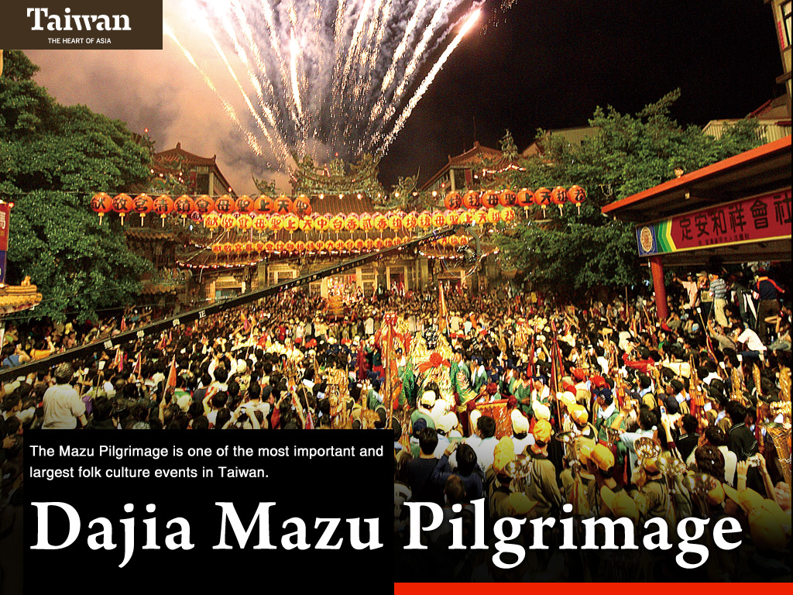
Notes:
the Dajia Mazu pilgrimage,

Slide 37
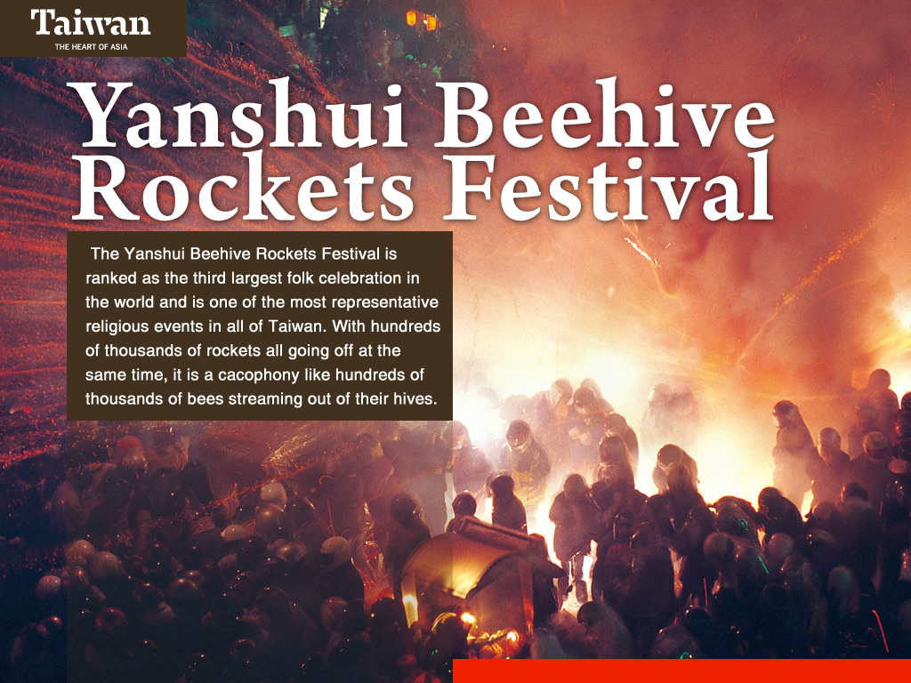
Notes:
the Yanshui Beehive Rockets Festival,

Slide 38
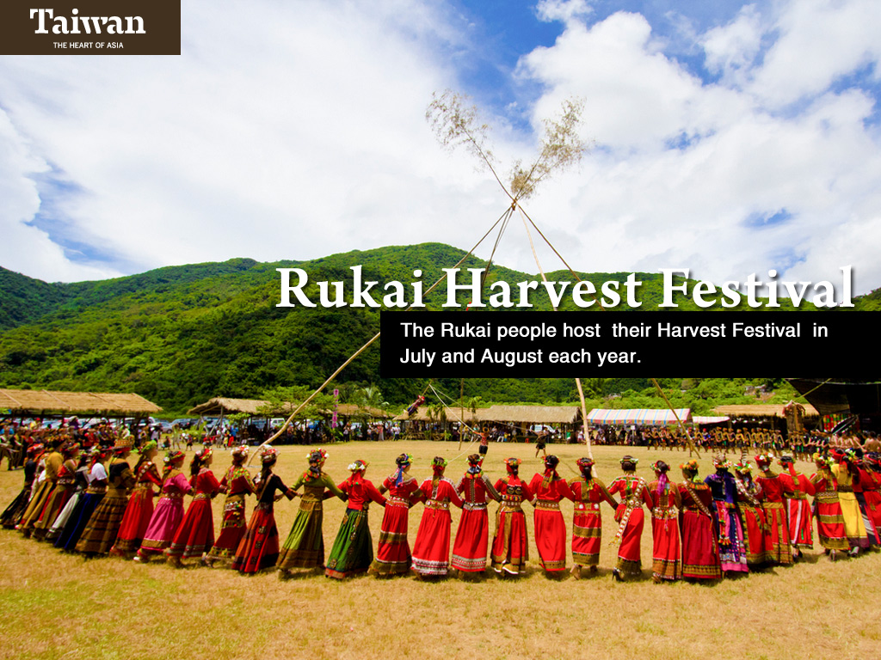
Notes:
and the indigenes people’s harvest festival. If you choose to visit Taiwan at the right time, you’ll be lucky to have these unforgettable experiences.

Slide 39
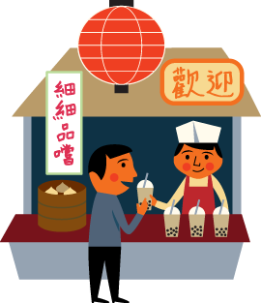
18:00 p.m.
Sights and Sounds
Notes:
Taiwan’s diversity also extends to its unique sights and sounds. There is truly something for everyone to enjoy.

Slide 40
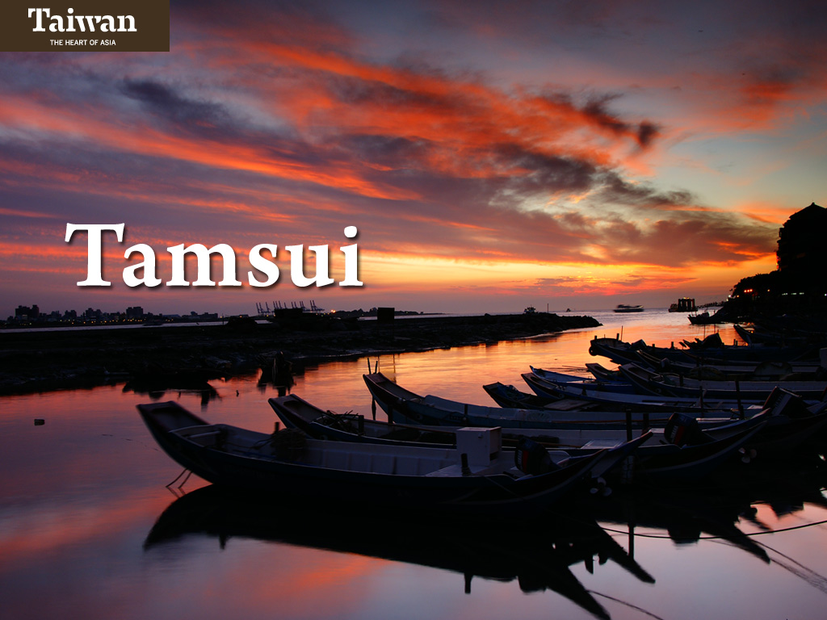
Notes:
The Tamshui River is the main waterway through Taipei City. Tamshui District was once an important shipping and commerce center in the 19th century. Take a ferry across the river to Bali District of New Taipei City. Along both sides of the river are beautiful bike paths.

Slide 41
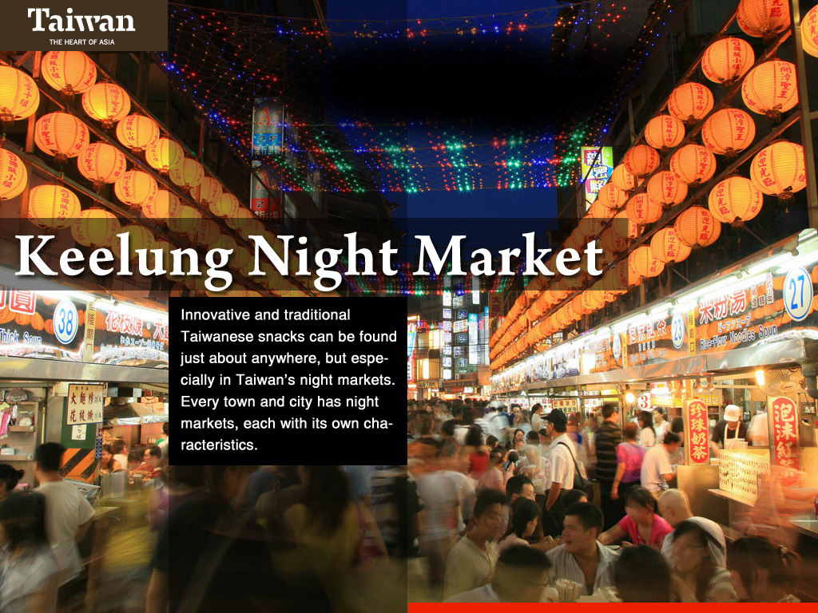
Notes:
Night markets are among the most popular attractions for visitors.

Slide 42

Notes:
Of course, you can choose to spend your evening at a vibrant shopping, dining and entertainment area.

Slide 43
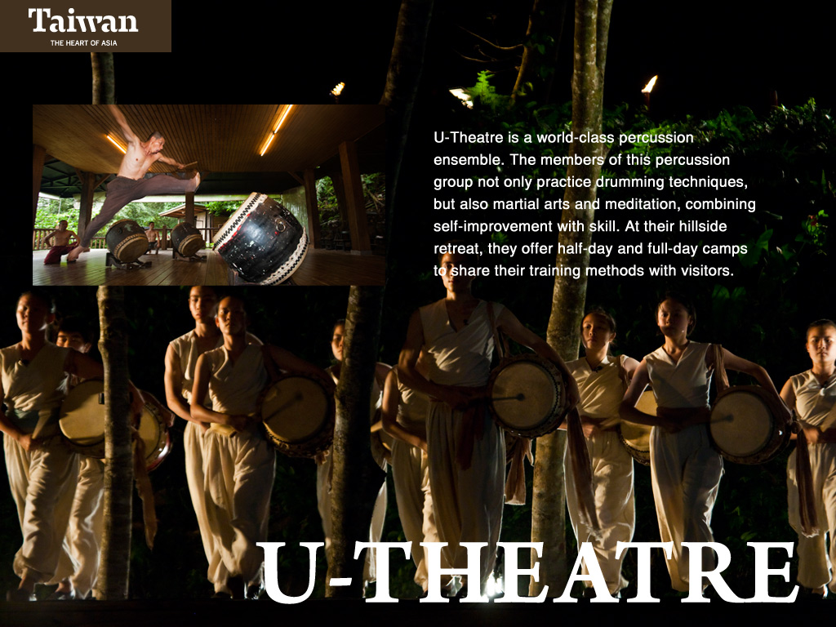
Notes:
And enjoy a world class performance.

Slide 44

Notes:
If you have filled up on food at the night market and are looking for food for the mind, try a 24-hour bookstore.

Slide 45

Notes:
For a unique souvenir of Taiwan, visit some of the shops that sell products developed by Taiwan’s contemporary designers.

Slide 46

22:00 p.m.
Nightlife
Notes:
There is plenty to do in Taiwan once the sun goes down.

Slide 47

Notes:
Taiwan is a safe country, so feel free to venture out at night. Cycling is a great experience no matter whether the sun is up or down.

Slide 48
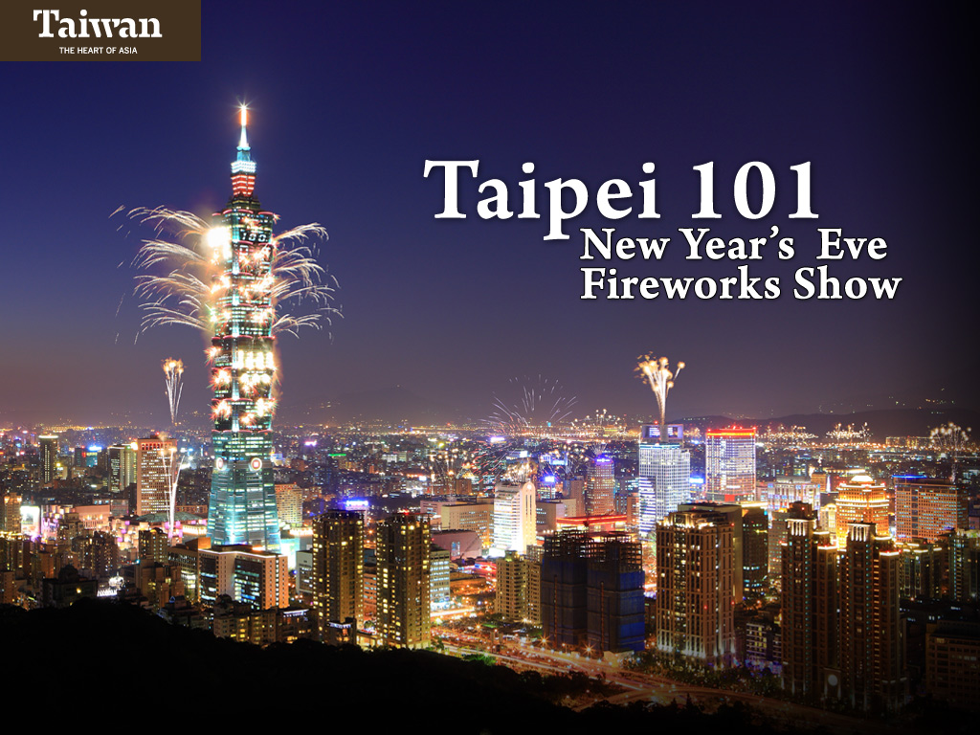
Notes:
Taipei 101 is the world’s tallest green building. From here, you can see stunning panoramic views of the city. The most spectacular night show is the fireworks display at midnight on New Year’s Eve.

Slide 49
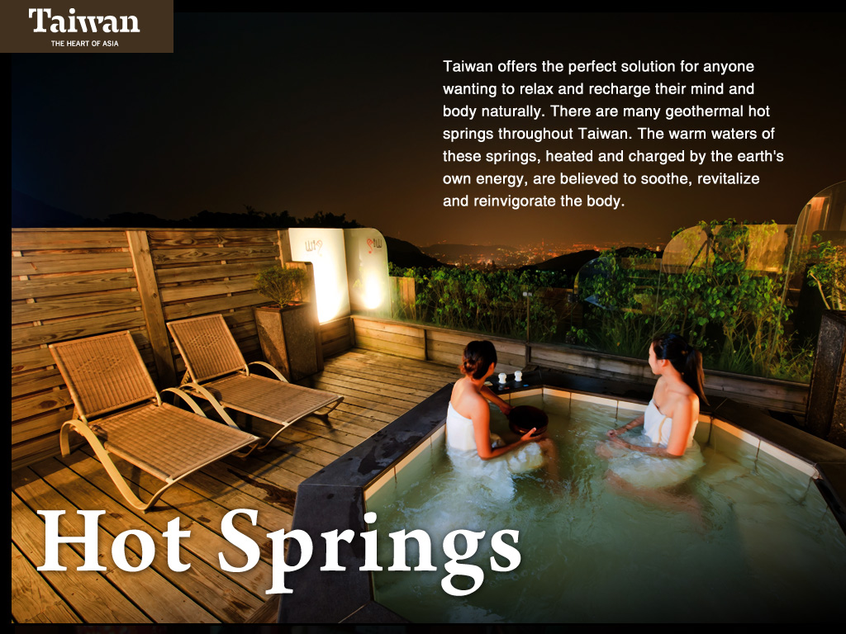
Notes:
Due to its high mountains and volcanic past, Taiwan possesses one of the richest concentrations of hot springs in the world.

Slide 50

Notes:
Away from the bright lights of the city, the stars shine brightly. This is Nature’s form of entertainment.

Slide 51

Notes:
By massaging these acupressure points it is possible to understand which organs are in need of attention.

Slide 52
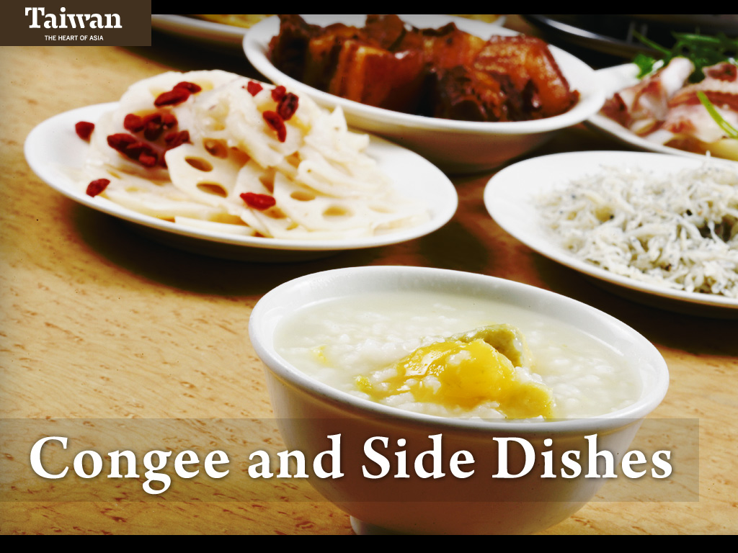
Notes:
Congee is a watery rice mixture to which can be added a variety of foods such as dried pork floss, stir-fried vegetables and peanuts.

Slide 53
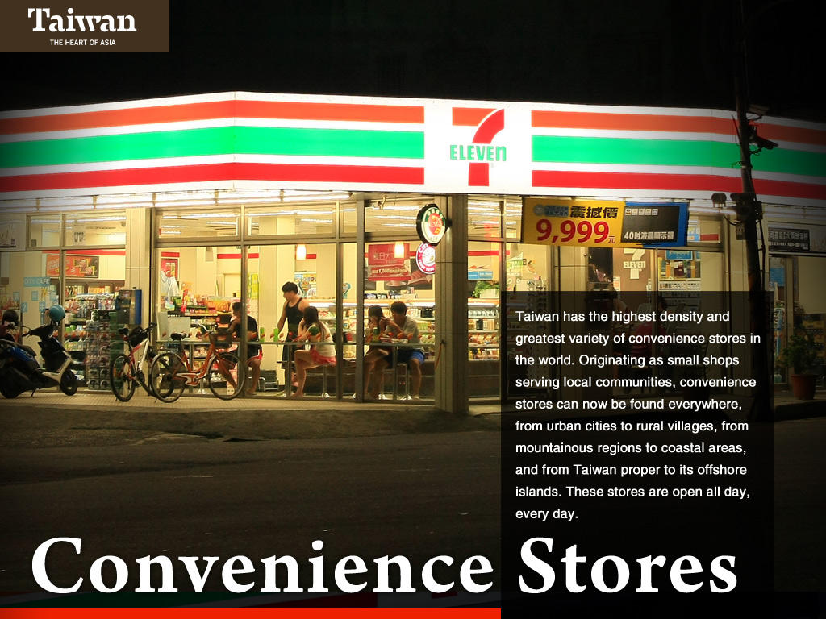
Notes:
Taiwan has the interesting distinction of having the highest density of convenience stores in the world.

Slide 54
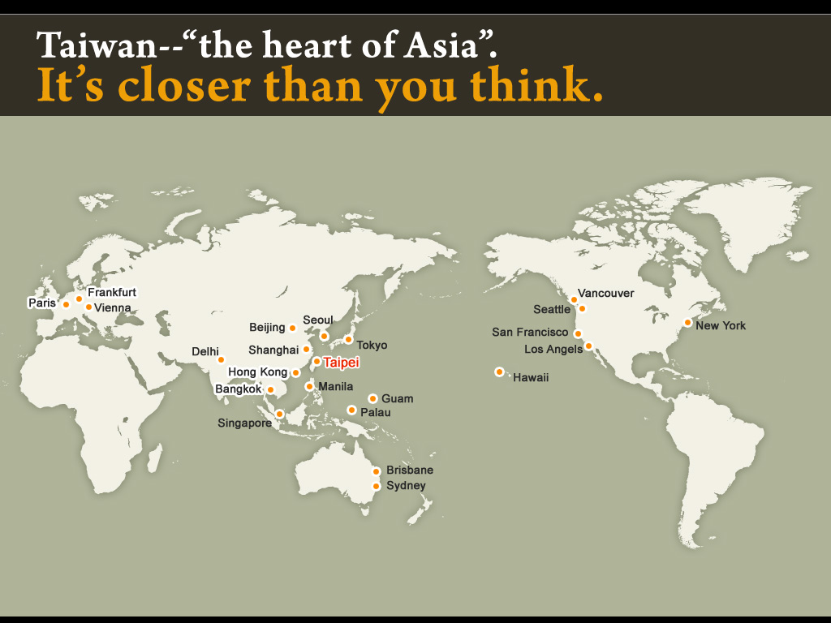
Notes:
Being in the heart of Asia, it is easy to travel to Taiwan with direct flights from many destinations such as Los Angeles, New York, Vancouver, Paris, Frankfurt, and Sydney.

Slide 55
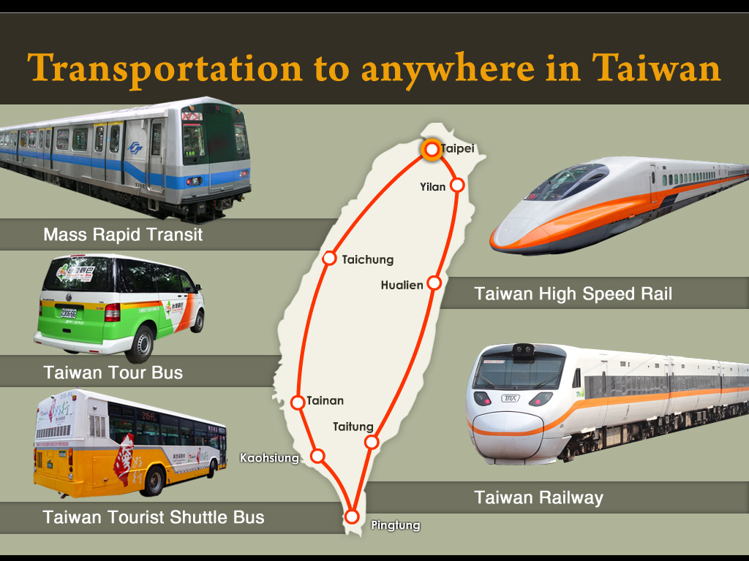
Notes:
Getting around Taiwan is easy. The Taiwan Tourist Shuttle Bus and Taiwan Tour Bus have many routes to tourist destinations. Public transportation includes metro or subway systems in Taipei and Kaohsiung, a railway system that circles the island and the high speed rail system between Taipei and Kaohsiung.

Slide 56
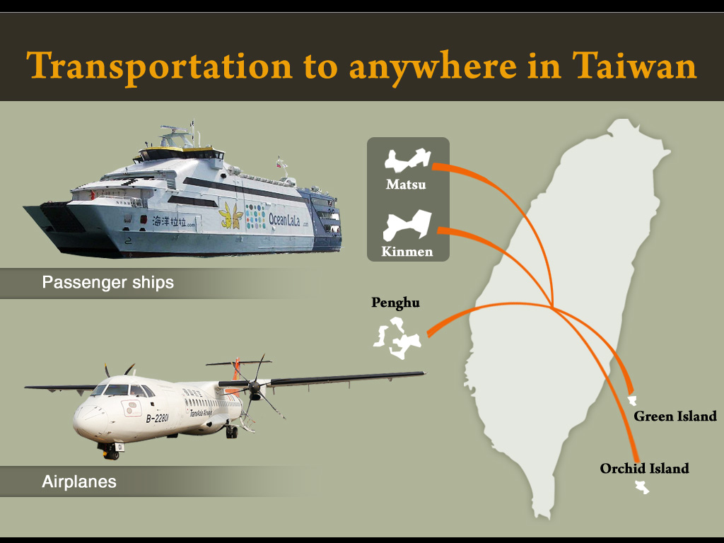
Notes:
Although Taiwan is itself an island, its territory includes Kinmen, Matsu, Penghu, Green Island and Orchid Island. Each of these islands offers a unique experience and can be reached by domestic flight or ferry.

Slide 57
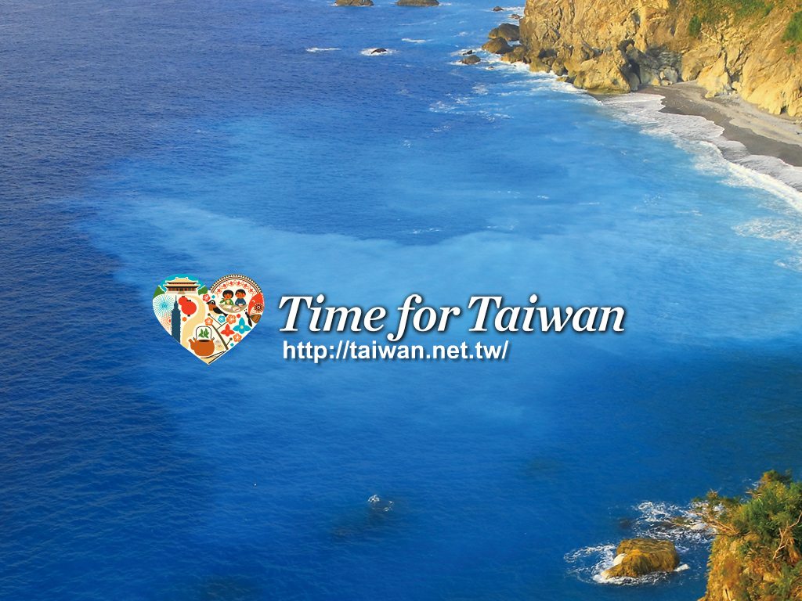
Notes:
Thank you for your time. I hope I have convinced you that now, it’s time for Taiwan!

